Slide 1
Pointer Basics
CS 201, Summer 2013
*

Slide 2
ADDITIONAL READING
Pointers
  Chapter 10 of Pearson book
  http://www.learncpp.com/cpp-tutorial/67-introduction-to-pointers/
  http://www.learncpp.com/cpp-tutorial/68-pointers-arrays-and-pointer-arithmetic/

Slide 3
What are Pointers?
Pointers are similar to References in many ways.
Pointers were available in C, while References were not.
Pointers are a bit less restricted than References. Can potentially do more “damage”.
Pointers have more symbols to keep up with.

Slide 4
Asterisk
Something that can be confusing about pointers is the use of the asterisk *
Like References and &, the * means different things based on context.
For example, 4 * 5 is 4 times 5.

Slide 5
Declaring a Pointer
To declare a pointer, we can write:
Unlike references, pointers:
Don't need to be initialized
Can change what they're pointing at
Can point to “NULL” to symbolize nothing

Slide 6
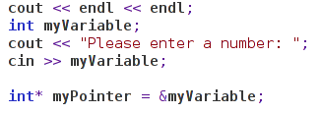
Assigning a value to a pointer
A pointer must store a memory address.
To get a variable's memory address, we use the address-of operator:
Assign pointer-variables memory addresses with the & “address-of” operator.

Slide 7
Outputting Pointer data
If we output the Pointer-Variable name on its own, we get a memory address:
If we output the Pointer-Variable with a dereference operator, we get the stored data:

Slide 8
De-reference Operator
The De-reference operator is also an asterisk *
When placed behind a pointer-variable, you will get the data of the variable that is being pointed to.
You cannot use the de-reference operator on a normal variable.

Slide 9

Declare & De-reference
Declare a pointer:
De-reference a pointer (ONLY a pointer):
The Asterisk * goes between the data-type and the variable-name
The Asterisk * goes before a variable name, and that variable MUST be a pointer.
You will get a compile error if it's a normal variable or a reference variable.

Slide 10
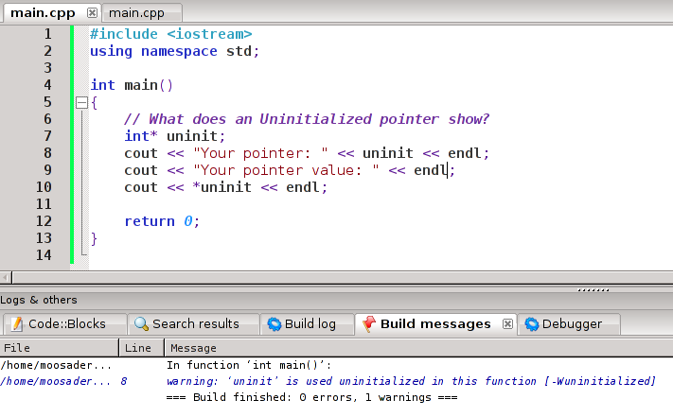
Uninitialized Pointers
What does an uninitialized pointer do?
Notice “uninitialized” warning.

Slide 11


Uninitialized Pointers
What does an uninitialized pointer do?
Trying to de-reference an uninitialized pointer
Gives you a segmentation fault.
This will cause your program to crash and exit.

Slide 12

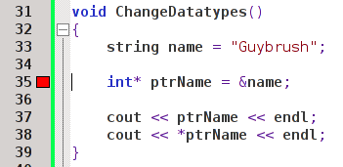

Pointer Datatypes
You can point to any kind of data-type.
You cannot cross data-types!
User-created
Struct!

Slide 13
REVIEW
3. Which symbol represents each of these?
Reference Variable
Pointer Variable
De-reference Operator
Address-of Operator

Slide 14
REVIEW
2. Which of these cannot be changed once initially assigned?
Pointer
Reference

Slide 15
REVIEW
1. How do you assign a pointer-variable to a regular variable? What is the syntax?
int myNumber = 20;
int* ptrNumber = _____________?

Slide 16
Order of Operations
C++ follows the standard mathematical Order of Operations for math.
Pointers also follow an order of operations.

Slide 17
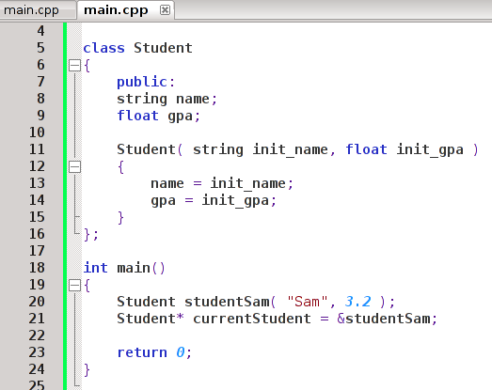
Order of Operations
Let's say we had a pointer to a class:
This works just fine, we create a Student object (Sam), and then we can point to a certain student.

Slide 18
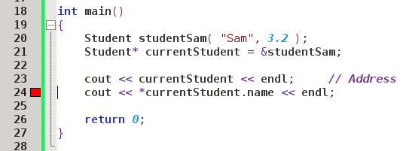
Order of Operations
If we output the “currentStudent” pointer, we would get a memory address.
There's also nothing to output with just the object name itself
  i.e., cout << *currentStudent << endl;

Slide 19
Order of Operations
If we try to use the de-reference operator * to access the student's data, and try to access the .name member, we get a compile error.
This is due to the order of operations:
C++ is trying (currentStudent.name) and THEN the pointer, which doesn't make sense.

Slide 20
Order of Operations
Instead of
*(currentStudent.name)
we want it to operate as
(*currentStudent).name

Slide 21

Order of Operations
(*currentStudent).name works!

Slide 22
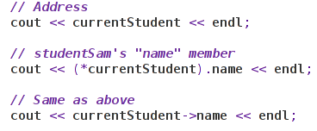
The arrow operator
You could use parenthesis to enforce the order of operations, or you could use another operator... ->
Arrow operator

Slide 23

NULL pointers
When you're done using a pointer, you should set it equal to NULL.
Then, you can use if statements to check whether the pointer is NULL to know whether or not to use it.
This will come in handy when we're doing memory management!

Slide 24
Naming Conventions
Since Pointers can cause trouble if you don't keep up with them, it is standard to prefix your pointer variables with the label “ptr”.
This way, you can easily differentiate between normal variables and pointer-variables in your code.
Student* ptrCurrentStudent = &studentSam;
Prefix variable names for great justice!

Slide 25
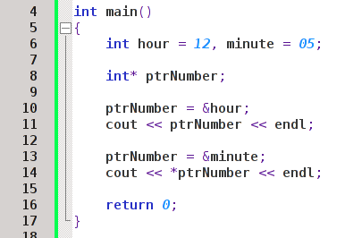
REVIEW
1. What will this program print out?

Slide 26
Addresses of Pointers
We can create a pointer-variable, which stores the memory address of some other variable.
A pointer-variable is still a variable, and it has its own memory address.
Therefore, you can also find the memory address of a pointer itself.

Slide 27
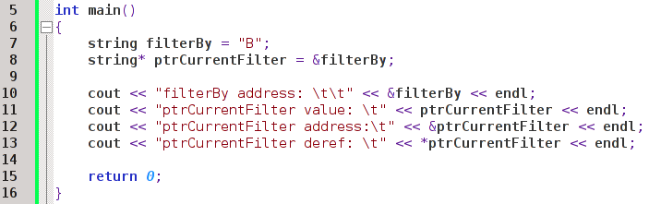

Addresses of Pointers
&ptrName gives address of pointer
Different Addresses!

Slide 28
Pointers as Arguments
Pointers can also be arguments, just like references.
  Can achieve the same ends:
    Returning multiple variables from a function
    Optimize program by not copying parameters

Slide 29
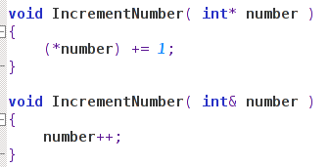
Pointers as Arguments
Passing as pointer
Passing as reference

Slide 30
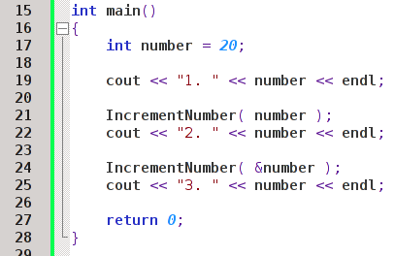

Pointers as Arguments
Reference version
Pointer version

Slide 31
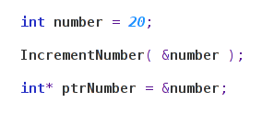
Pointers as Arguments
Just like when we declare a pointer we need to assign it the name of a variable, prefixed by ampersand (ie, the “address-of” operator)
If a function expects a pointer as a parameter, we must pass in that regular variable with an ampersand.

Slide 32

Pointers as Arguments
If we're passing in a pointer-variable to a pointer-variable parameter, we don't need to prefix the ampersand.
The address-of operator is only for turning a regular-variable into a pointer-variable.

